Slide 1

Crime Analysis:
Rebecca Manchester
Woz-u
6 august 2021

Slide 2

Background
Rebecca Manchester
Bachelor of Science in Political Science and Criminal Justice
University of Central Missouri 2008

Slide 3
Why this?
The cause of crime has always been a passion of mine and it is something that almost everyone is impacted by in some way
From how we travel to where we live
From where we work to our own opinions of social issues
Way too often we are faced with a “Not In My Backyard” approach to how we view crime rates, but we don’t always take it into a bigger picture of what they really are.

Slide 4
Methods
Yearly the FBI compiles reports in the Uniform Crime Report as well as the National Incident-Based Reporting System
These allow agencies around the country to report crime data to be evaluated
With this data I was able to track rates from 1981 to 2019 for the 7 major crime indexes which fall under Violent Crime and Property Crime
For violent crime those were Murder / Nonnegligent Manslaughter, Rape, Burglary, and Aggravated Assault
For property crime those were Robbery, Larceny/Theft, and Motor Vehicle Theft

Slide 5
Methods Continued
This was based on overall reported crime across the country. The crime rates are based on the crime in relation to the overall estimated population.
The reports were able to break down those crimes by states and even down to by the city

Slide 6
Let’s Take a look at How Crime has trended since 1981
Violent Crime and Property Crime have both trended down even though the population of the United States has constantly increased

Slide 7
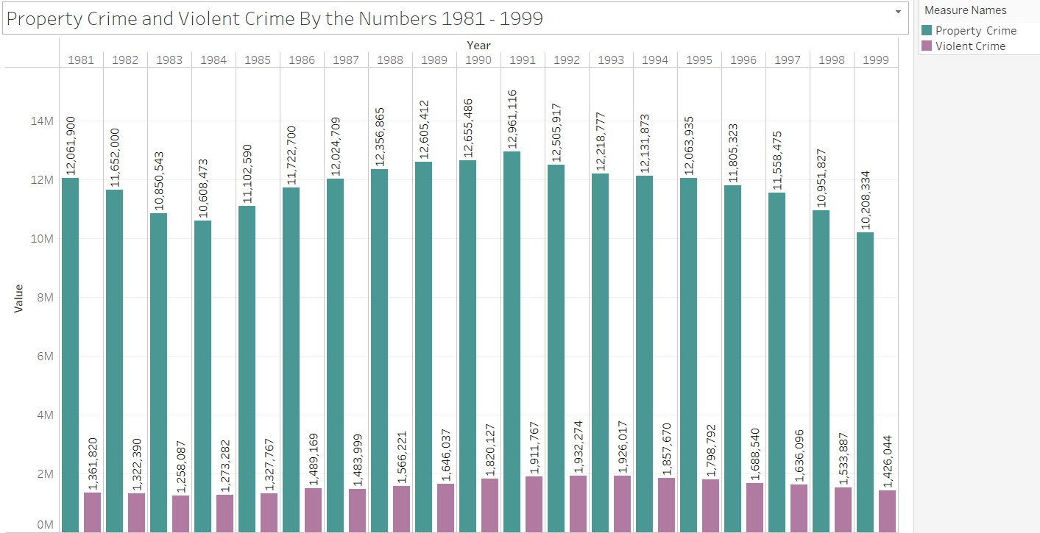

Slide 8
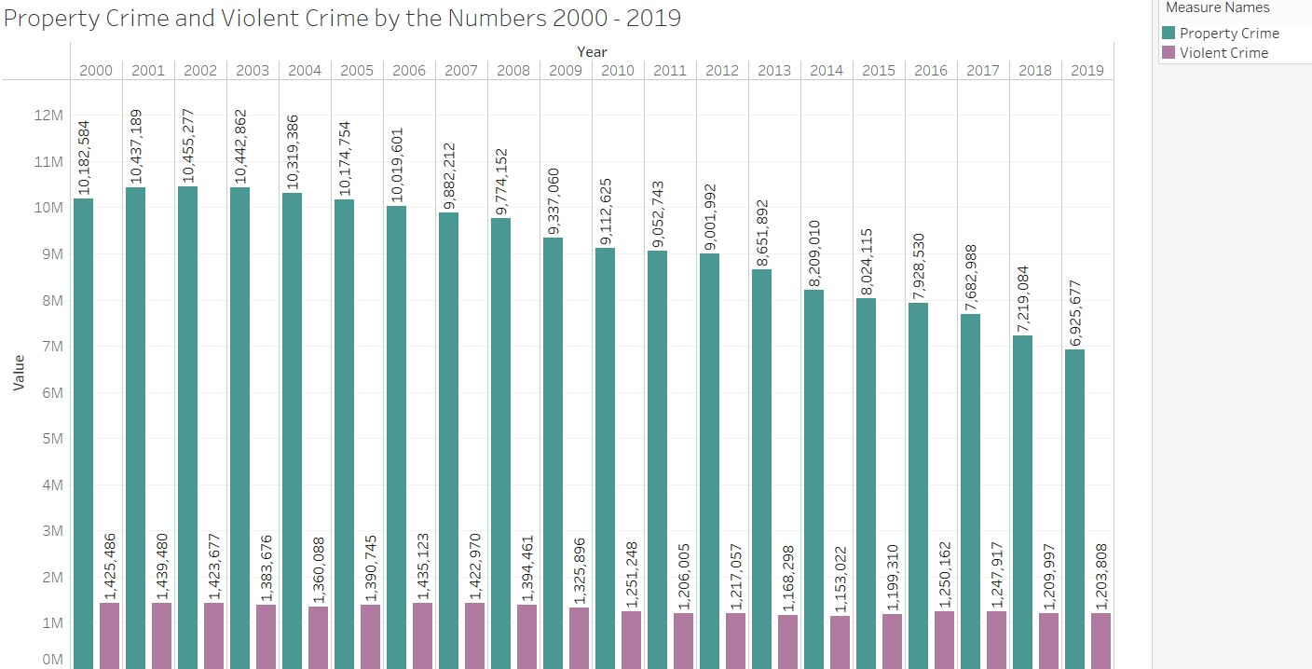

Slide 9
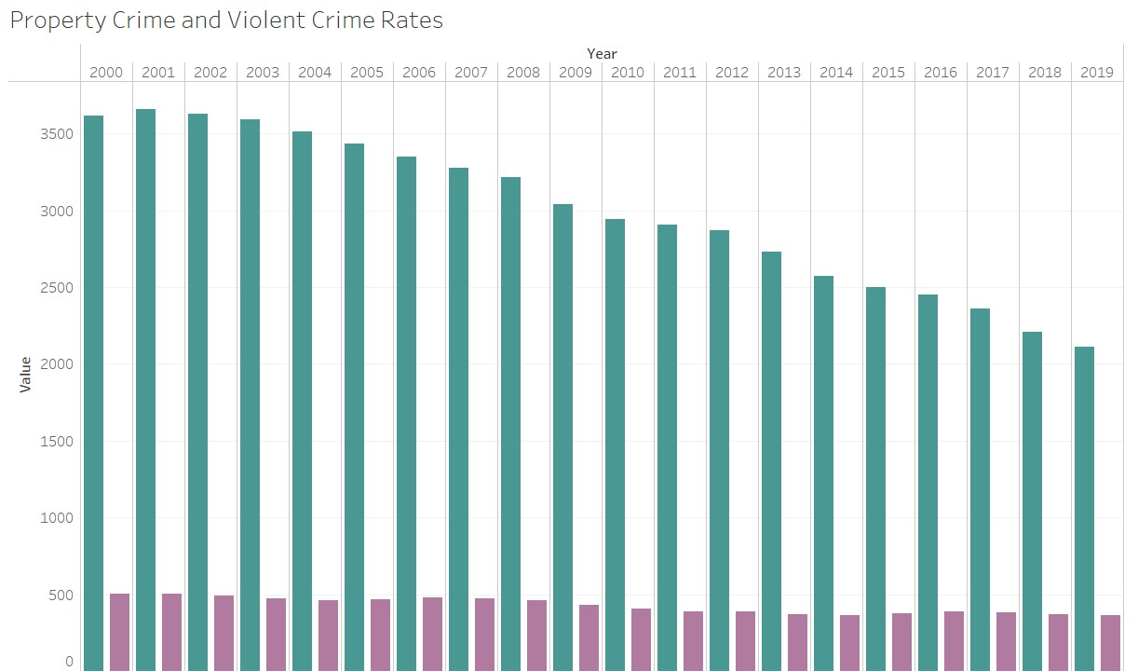
As violent crime rates trend down so do property crime rates

Slide 10

This can tell us a lot but maybe not what we really want to know…

Slide 11
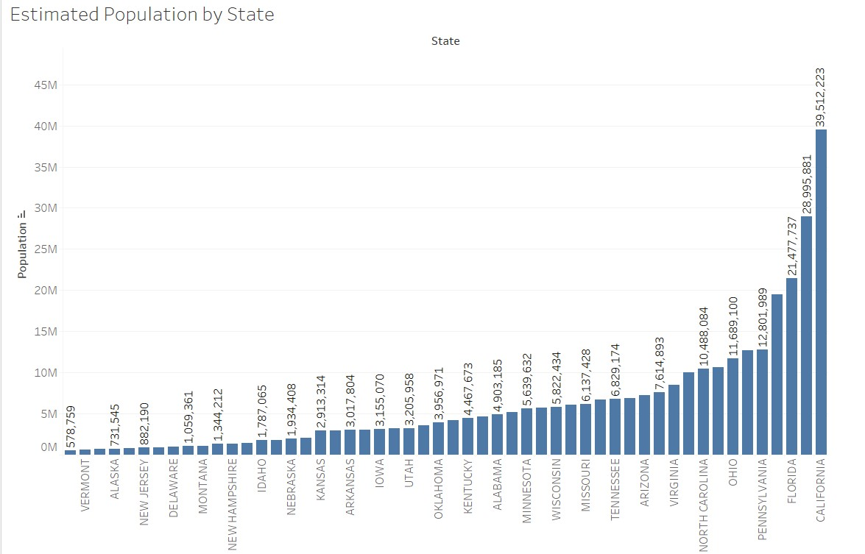
Let's take a quick peek at population breakdown overall…

Slide 12
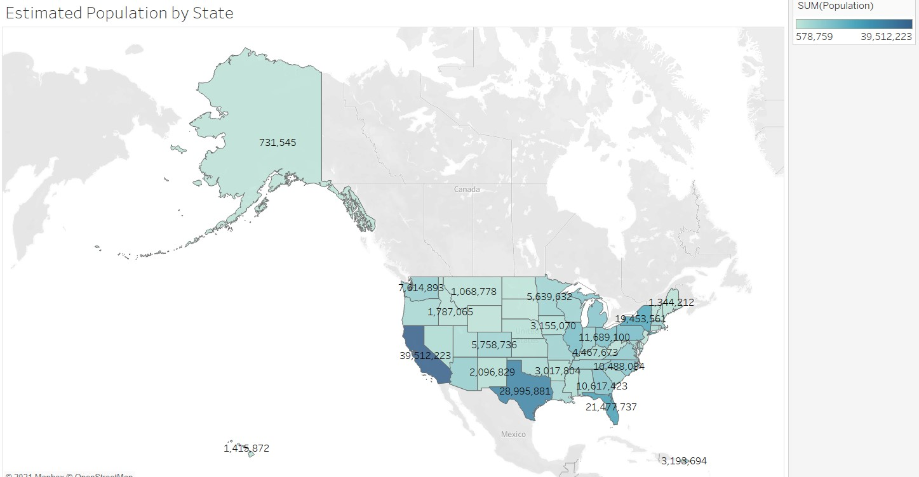

Slide 13

Let's start with property crime…

Slide 14
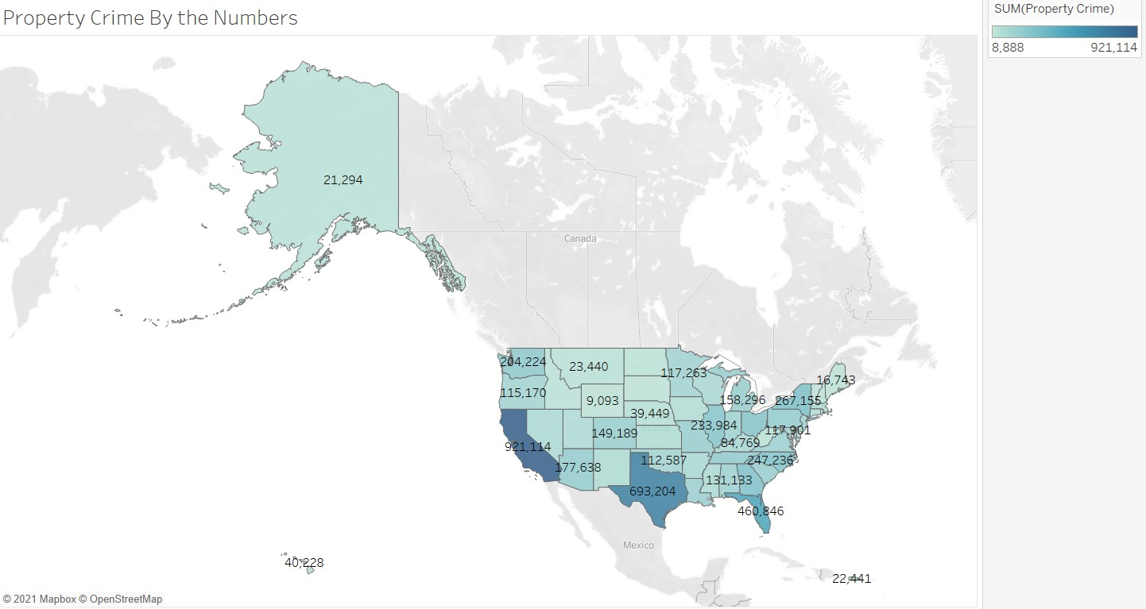

Slide 15
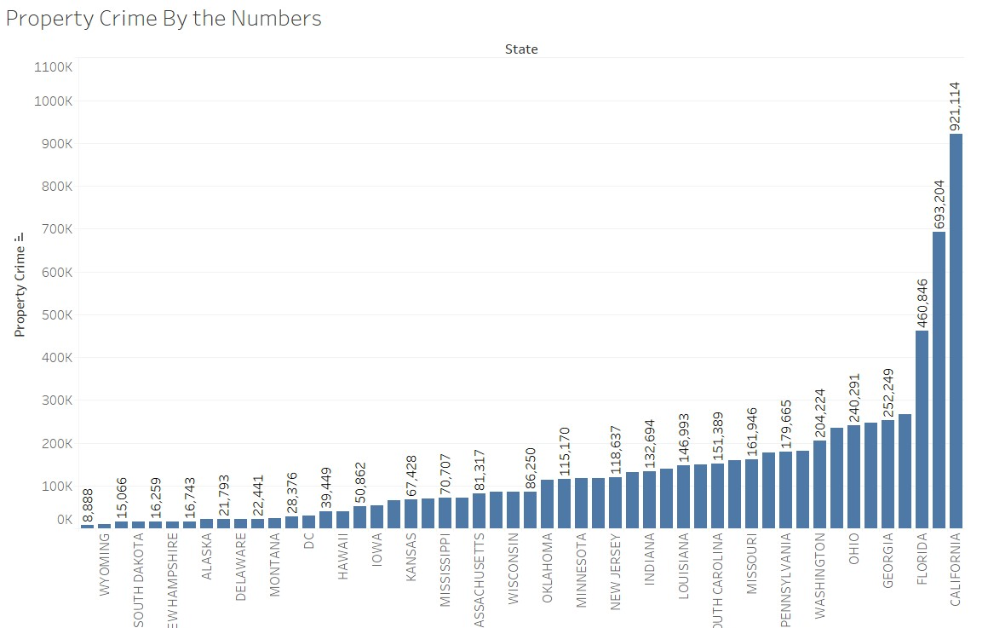

Slide 16
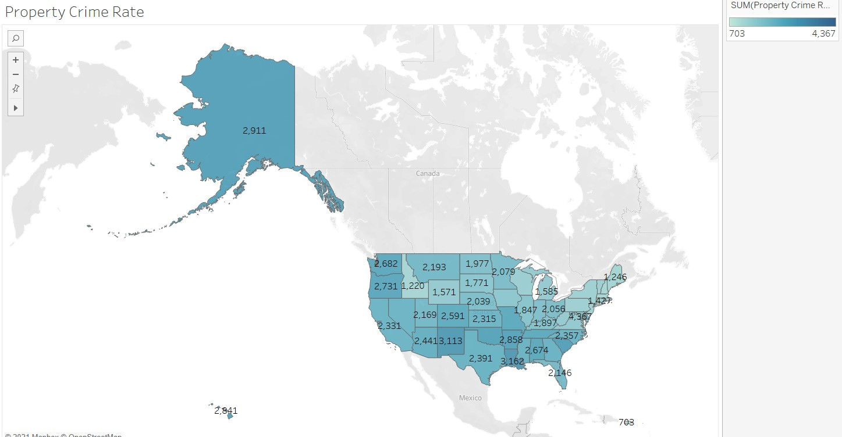

Slide 17
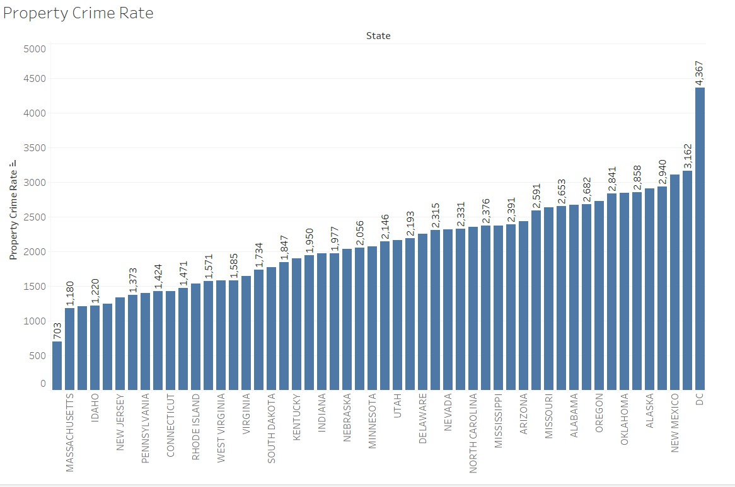
Things aren’t always as they seem… are they?
Just because a state has more crime by the numbers does not mean it has more crime in comparison
But we can break this down a little more to see what cities have the most property crime

Slide 18
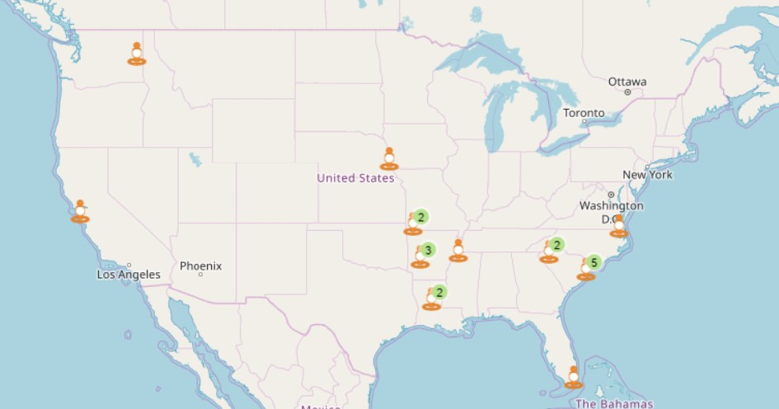
Top 20 Cities for Property Crime in the United States (2019)
Myrtle Beach SC
Alexandria VA
Springfield MO
Miami Beach FL
Joplin MO
Hot Springs AR
Florence SC
North Myrtle Beach SC
Monroe LA
Spartanburg SC
Oakland CA
Asheville NC
Memphis TN
Little Rock AR
North Charleston SC
Spokane WA
Portsmouth VA
Council Bluffs IA
Goldsboro NC
Fort Smith AR
20 Cities with the Most Property Crime - Insurify

Slide 19
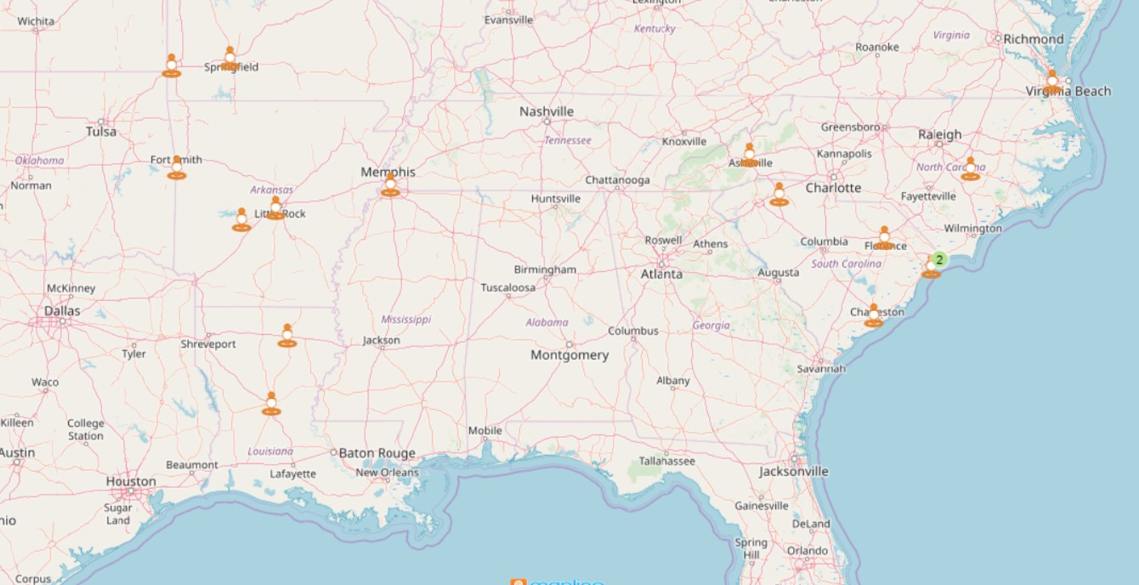
If we take a quick look at a zoomed in portion of the map, you can see that 16 of the 20 points are all located in this area. In fact 5 points are in South Carolina alone.
20 Cities with the Most Property Crime - Insurify

Slide 20
Now let's dive into violent crime…

Slide 21
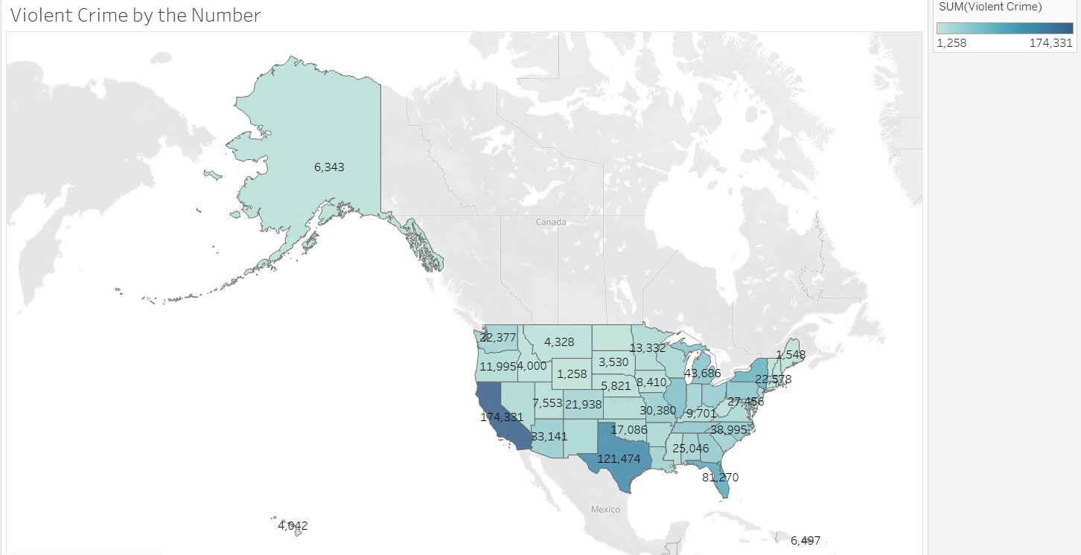

Slide 22
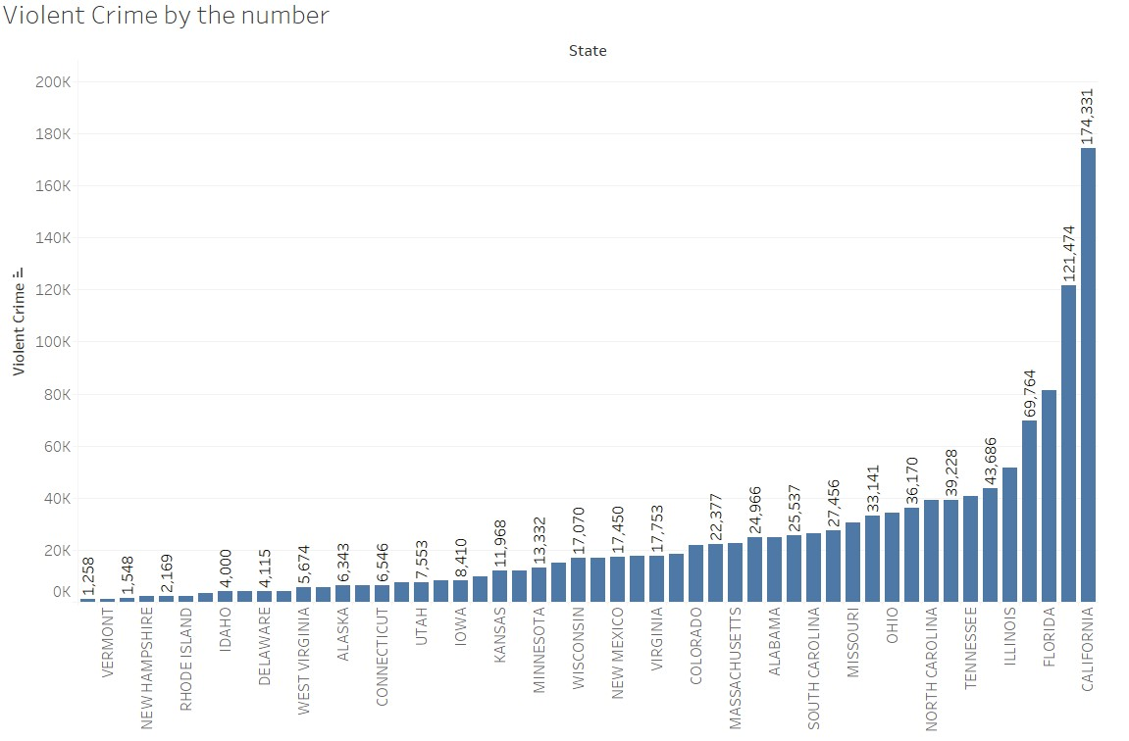
Yet another bit of skewed data because of the population differences

Slide 23
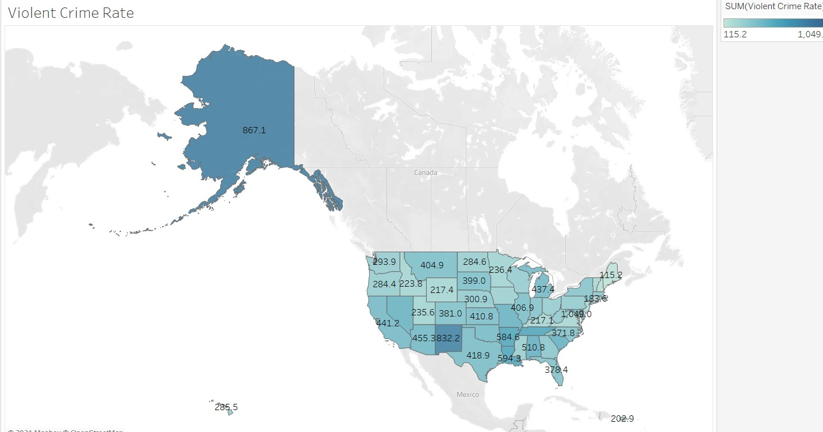

Slide 24
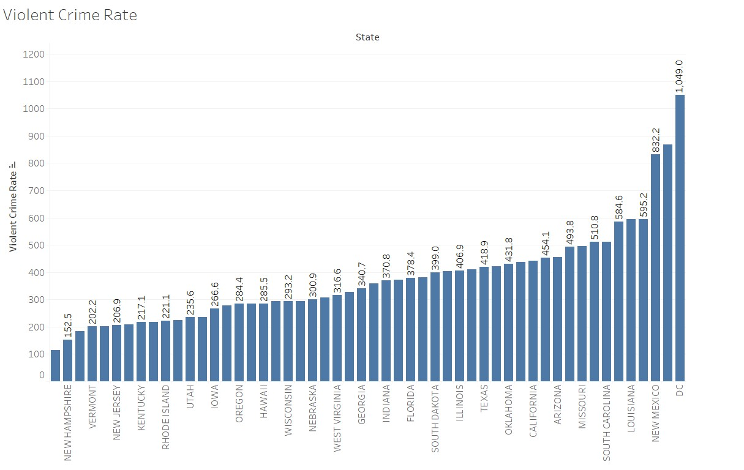
Things change quite a bit when you switch to looking at it by rate instead of by number

Slide 25
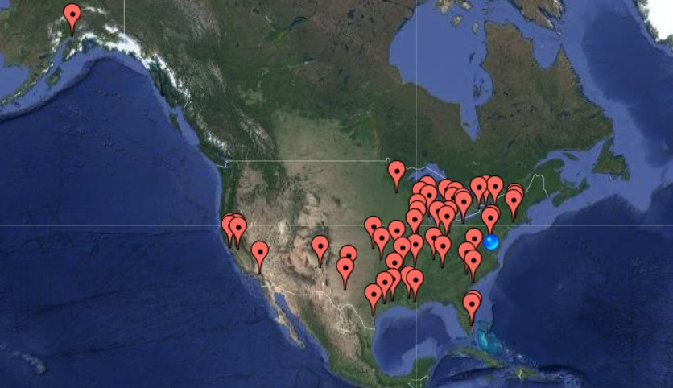
Most Violent Cities in the United States

Slide 26
Most Violent Cities in the United States 2019
Detroit MI
St Louis MO
Memphis TN
Baltimore MD
Springfield MO

Slide 27
Most Violent Cities in the United States 2019
Wichita KS
Nashville TN
Houston TX
Lansing MI
Chattanooga TN
Little Rock AR
Cleveland OH
Stockton CA
Albuquerque NM
Milwaukee WI
San Bernardino CA
Oakland CA
Anchorage AK
Rockford IL
New Orleans LA

Slide 28
Most Violent Cities in the United States 2019
Beaumont TX
Peoria IL
Odessa TX
Lubbock TX
Buffalo NY
Tulsa OK
Washington DC
North Charleston SC
Dayton OH
Toledo OH
Chicago IL
Baton Rouge LA
Minneapolis MN
Springfield MA
Akron OH

Slide 29
Most Violent Cities in the United States 2019
New Haven CT
Indianapolis IN
Hartford CT
Vallejo CA
Cincinnati OH
Greensboro NC
Modesto CA
Corpus Christi TX
Pompano Beach FL
Syracuse NY
Shreveport LA
Springfield IL
Columbia SC
West Palm Beach FL
Rochester NY

Slide 30
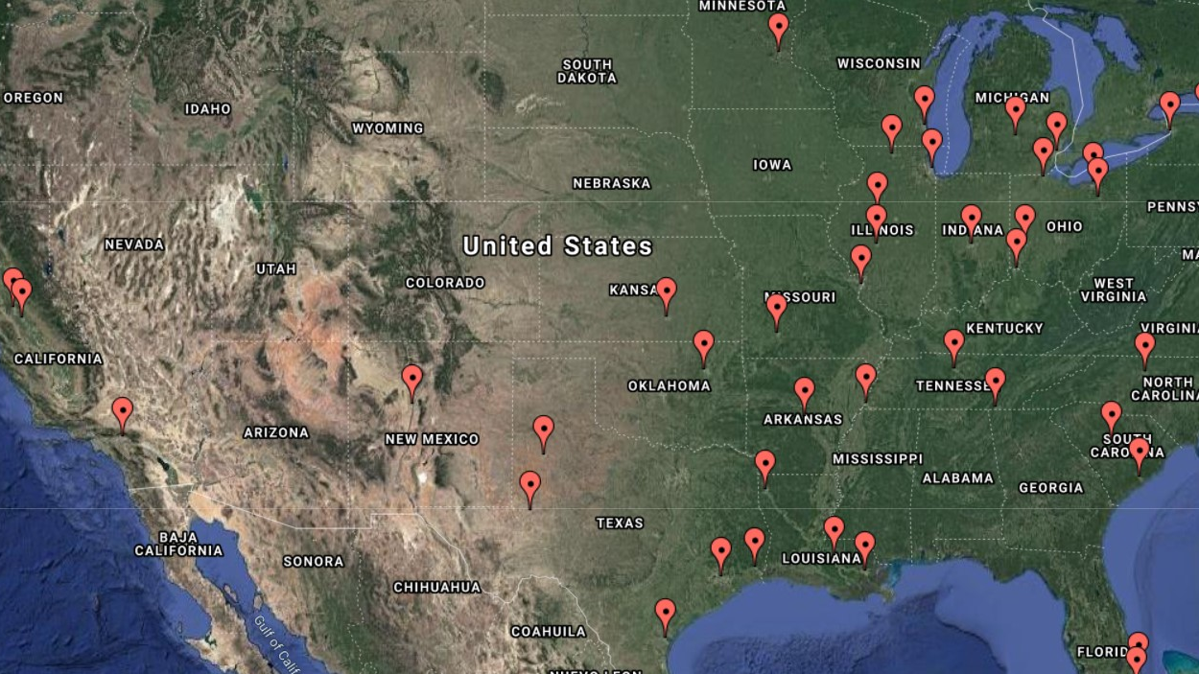
The most dangerous cities in the country are in the Midwest! California, Illinois, Ohio and Texas have the largest numbers of cities on the list.

Slide 31

Which 3 cities appear on both lists???
Springfield MO
North Charleston SC
Little Rock AR

Slide 32
Let's break down the trends over the years…
When we think about violent crimes the main crimes, we think about are:
Murder/Non Negligent Manslaughter
Rape

Slide 33
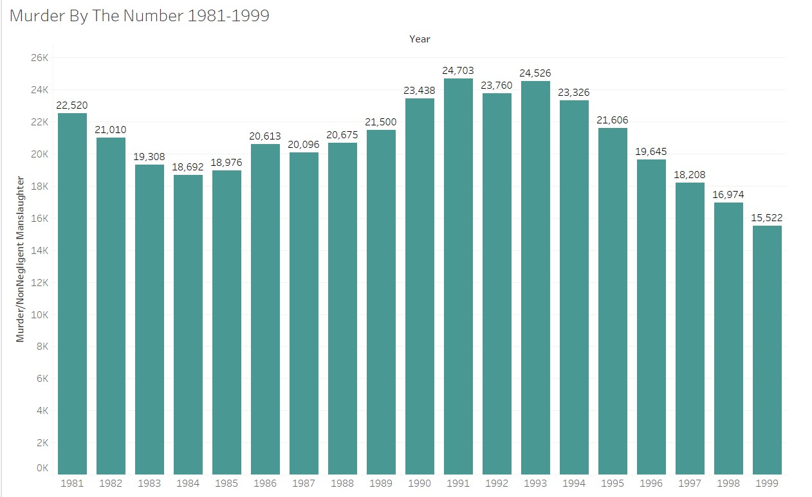
The early to mid 90’s had rather high murder numbers and rates

Slide 34
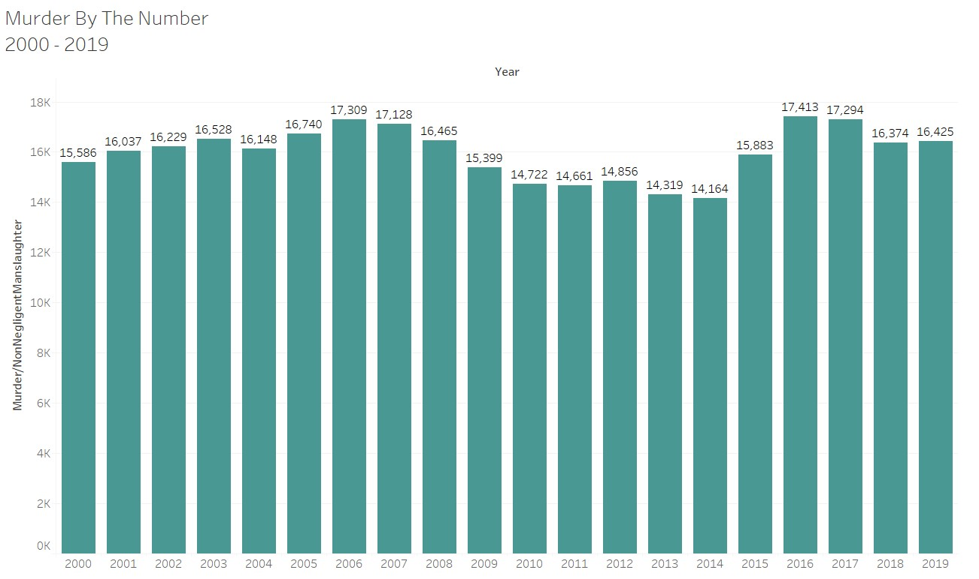
Those numbers are even much higher than today's yearly murders.

Slide 35
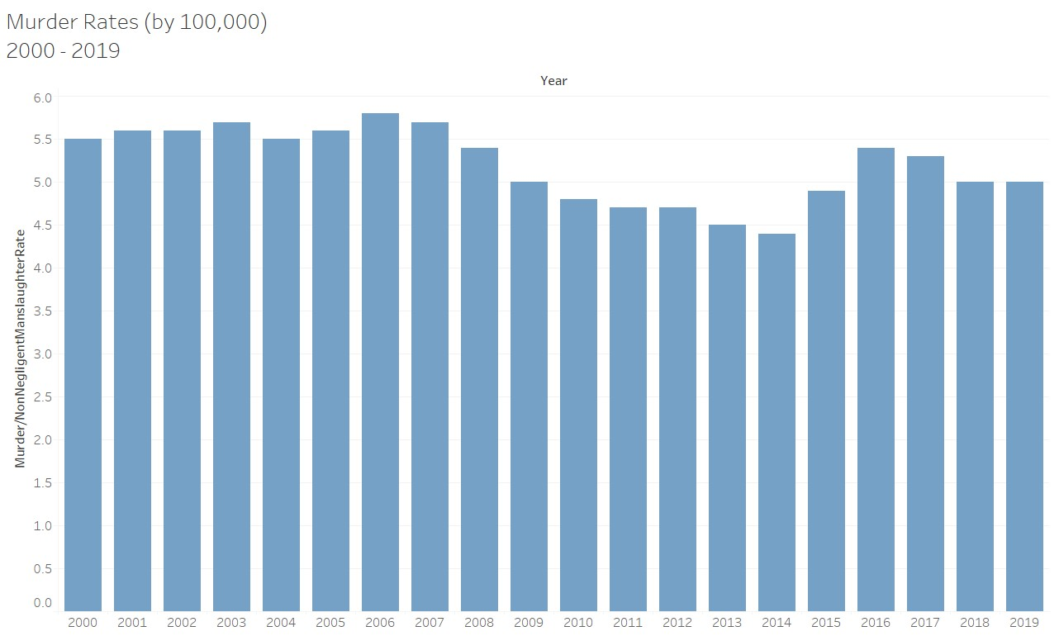
But overall the murder rate for the last 20 years have had ebbs and flows, and have stayed relatively steady

Slide 36
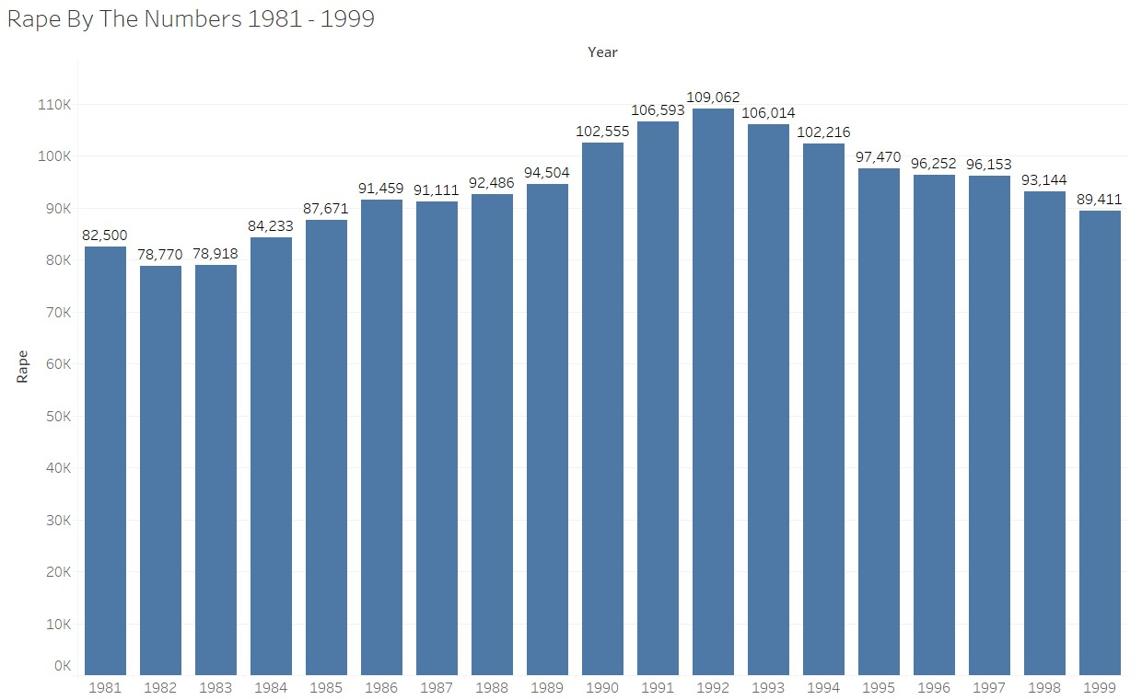
However, when looking at the number of rapes things can get a little more startling

Slide 37
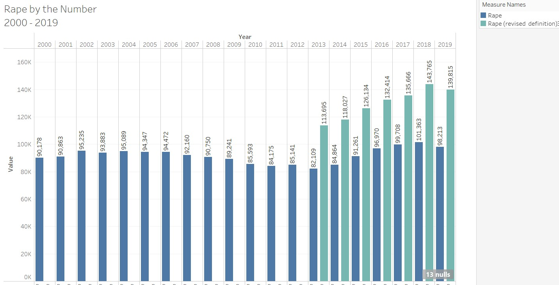
When the definition of rape was finally changed to include all forms of rape the yearly statistics greatly increased.

Slide 38
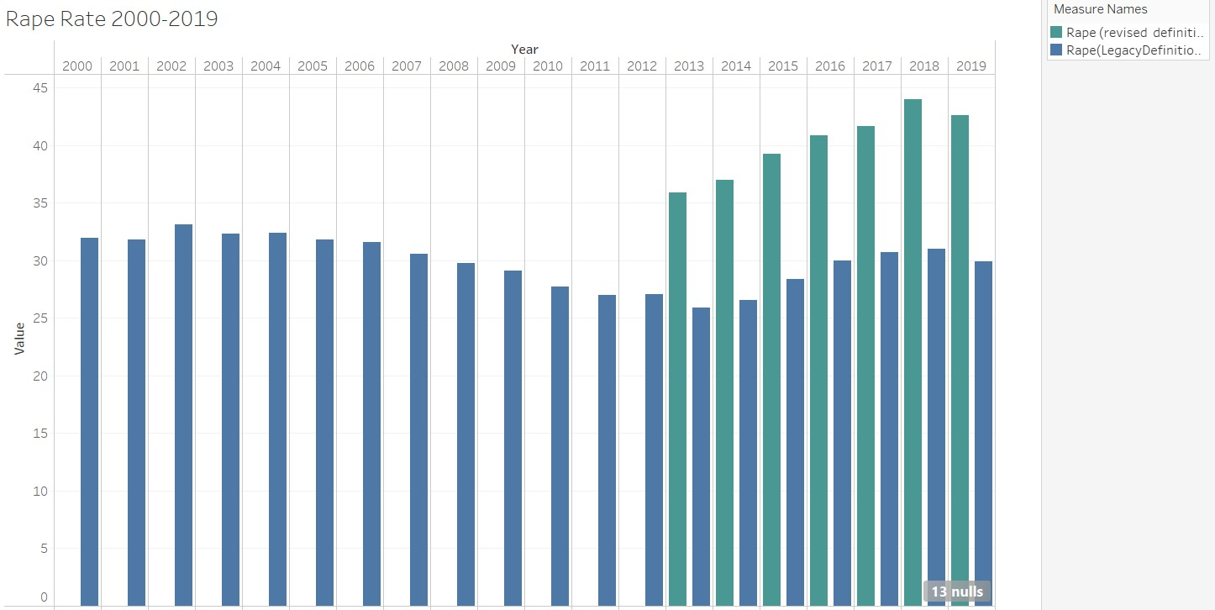
The rape rates dropped in 2019 after a long-term trend up

Slide 39
Summary
Property crime of any form predicts other property crime as well as murder and rape.
All violent crime predicts other violent crime nearly 100% of the time.
When it comes to crime, it is very easy to skew perception. Crime rates are down overall even though the social changes nationwide would suggest otherwise.

Slide 40
Conclusions
Understanding crime rates and trends can help see where it is safe to travel and live (and maybe some areas you should avoid).
Note: Springfield MO, Little Rock AR and North Charleston SC
Its important to note overall crime is trending down. Unlike in the past this seems to be continuing no matter what political or social trends are happening.
Crime isn’t going anywhere, it might change and mutate over the next few decades but there will always be crime of some sort and it is always useful to be able to predict and track trends over time.

Slide 41

Questions?

